Slide 1
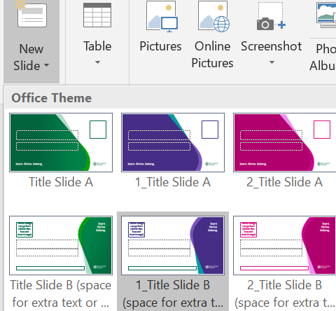
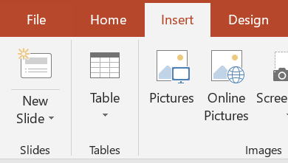
Welcome to the education master slide deck for West Lothian Council
The font is set to Source Sans Pro our corporate font. The size is set to 20pt but if you need to you can reduce this, however we would recommend not going below 16pt for legibility.
The colours have been set in the presentation theme. Colours for hyperlinks, shapes and arrows have also been set up so don’t worry about them.
There are title slides and content slide options.
The title slides contain an area to include the School Badge.
All have an option for a single or double column text box. Feel free to use whatever one you want.
To add a new slide to your presentation, click
on the small arrow next to ‘New Slide’. This will show all the options available. Pick the one you want, and this will appear in your presentation.
Delete this guide slide in your copy.

